Slide 1
FIRST BANK
CAMPAIGN ANALYSIS
Customer conversion, campaign efficiency and practical priorities
“Giant In You” Campaign 2024

Slide 2
FIRST BANK CAMPAIGN ANALYSIS
The campaign converted almost half of all customers
11,162
5,289
47.38%
TOTAL CUSTOMERS
SUBSCRIBERS
SUBSCRIPTION RATE
Customers included in the campaign data
Customers who accepted the deposit offer
Overall campaign conversion
1,529
AVERAGE ACCOUNT BALANCE
Average balance held by customers
The campaign achieved a strong 47.38% conversion rate, but performance varies sharply by previous outcome, contact channel, call duration and customer profile. Those differences provide clear opportunities to improve targeting and reduce wasted contact attempts.
02
Notes:
[Sources]
- User-provided workbook: Bank Campaign (First Bank)SKILL COMPLETE PROJECT 2(1).xlsx
[/Sources]

Slide 3
FIRST BANK CAMPAIGN ANALYSIS
Clean, standardised data supports reliable comparisons
What was cleaned
How quality was protected
• Standardised capitalisation across customer categories
The main customer fields were complete across 11,162 records. Calculated summary cells were kept separate from row-level variables, duplicate category spellings were aligned, and percentages were recalculated from subscription counts rather than copied blindly from charts.
• Split combined day/month fields for time analysis
• Grouped ages, balances, call durations and contact counts
• Corrected the subscription-rate label and checked totals
Final validation: 5,289 Yes + 5,873 No = 11,162 customers
This cleaning makes category comparisons reliable and prevents formatting differences—such as ‘admin.’ versus ‘Admin.’—from splitting the same customer group across multiple chart entries.
03
Notes:
[Sources]
- User-provided workbook: Bank Campaign (First Bank)SKILL COMPLETE PROJECT 2(1).xlsx
[/Sources]

Slide 4
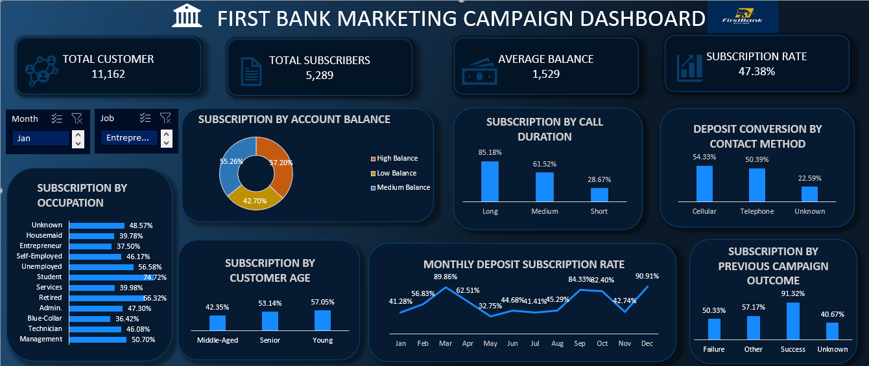
EXECUTIVE DASHBOARD

Slide 5
FIRST BANK CAMPAIGN ANALYSIS
5,289 customers subscribed to the deposit product
47.38%
overall subscription rate
The campaign is close to an even split, with 584 more non-subscribers than subscribers.
The overall result is strong enough to build on, but the remaining 52.62% non-conversion means targeting and contact execution still have substantial room for improvement.
05
Notes:
[Sources]
- User-provided workbook: Bank Campaign (First Bank)SKILL COMPLETE PROJECT 2(1).xlsx
[/Sources]

Slide 6
FIRST BANK CAMPAIGN ANALYSIS
Previous campaign success is the strongest conversion signal
Customers with a successful previous outcome convert at 91.32%—more than double the 40.67% rate for customers with no known outcome. Previous responders should therefore be treated as a high-priority audience for future campaigns.
06
Notes:
[Sources]
- User-provided workbook: Bank Campaign (First Bank)SKILL COMPLETE PROJECT 2(1).xlsx
[/Sources]

Slide 7
FIRST BANK CAMPAIGN ANALYSIS
Longer conversations are closely linked to subscription
Conversion rises from 28.67% for short calls to 85.18% for long calls. Duration is partly an outcome of customer interest rather than a factor the bank can simply extend, but it remains a powerful real-time signal for lead quality and agent follow-up.
07
Notes:
[Sources]
- User-provided workbook: Bank Campaign (First Bank)SKILL COMPLETE PROJECT 2(1).xlsx
[/Sources]

Slide 8
FIRST BANK CAMPAIGN ANALYSIS
Identified contact channels outperform unknown contact details
Cellular contact delivers a 54.33% subscription rate, while unknown contact records convert at only 22.59%. Improving contact-data completeness and prioritising verified mobile numbers could remove one of the clearest sources of campaign underperformance.
08
Notes:
[Sources]
- User-provided workbook: Bank Campaign (First Bank)SKILL COMPLETE PROJECT 2(1).xlsx
[/Sources]

Slide 9
FIRST BANK CAMPAIGN ANALYSIS
Repeated contact produces diminishing returns
Customers contacted once or twice convert at 50.63%, compared with 22.38% after 11 or more attempts. Heavy repetition is more likely to reflect weak interest than persistence paying off, so contact limits and earlier lead re-scoring would improve efficiency.
09
Notes:
[Sources]
- User-provided workbook: Bank Campaign (First Bank)SKILL COMPLETE PROJECT 2(1).xlsx
[/Sources]

Slide 10
FIRST BANK CAMPAIGN ANALYSIS
Young and senior customers respond more strongly
Young customers record the highest rate at 57.05%, followed by seniors at 53.14%; middle-aged customers fall to 42.35%. Messaging and product positioning should therefore be adapted by life stage rather than delivered as one broad offer.
10
Notes:
[Sources]
- User-provided workbook: Bank Campaign (First Bank)SKILL COMPLETE PROJECT 2(1).xlsx
[/Sources]

Slide 11
FIRST BANK CAMPAIGN ANALYSIS
Students and retirees are the most responsive job groups
Students lead at 74.72% and retirees reach 66.32%, while blue-collar and entrepreneur groups remain below 38%. These gaps support segment-specific propositions, but group size and affordability checks should be considered alongside conversion rate.
11
Notes:
[Sources]
- User-provided workbook: Bank Campaign (First Bank)SKILL COMPLETE PROJECT 2(1).xlsx
[/Sources]

Slide 12
FIRST BANK CAMPAIGN ANALYSIS
Customers with stronger balances convert more often
Conversion increases from 42.70% among low-balance customers to 57.20% in the high-balance group. Balance can improve targeting, although medium-balance customers offer the larger scalable opportunity because their conversion is nearly as strong and the segment is much bigger.
12
Notes:
[Sources]
- User-provided workbook: Bank Campaign (First Bank)SKILL COMPLETE PROJECT 2(1).xlsx
[/Sources]

Slide 13
FIRST BANK CAMPAIGN ANALYSIS
Existing loan commitments reduce subscription likelihood
Customers without housing loans convert at 57.03%, compared with 36.64% for those with housing loans. The same pattern appears for personal loans, suggesting that financial commitments may reduce capacity or willingness to take another product.
13
Notes:
[Sources]
- User-provided workbook: Bank Campaign (First Bank)SKILL COMPLETE PROJECT 2(1).xlsx
[/Sources]

Slide 14
FIRST BANK CAMPAIGN ANALYSIS
Tertiary-educated customers respond most strongly
Tertiary-educated customers had the highest subscription rate at 54.11%, while primary-educated customers recorded the lowest at 39.40%—a 14.71-percentage-point gap. Campaign communication should be simplified for customers with lower education levels, and “Unknown” records should be reviewed.
14
Notes:
[Sources]
- User-provided workbook: Bank Campaign (First Bank)SKILL COMPLETE PROJECT 2(1).xlsx
[/Sources]

Slide 15
FIRST BANK CAMPAIGN ANALYSIS
Single customers respond most strongly
Single customers had the highest subscription rate at 54.35%, while married customers recorded the lowest at 43.38%—a 10.97-percentage-point gap. The bank should tailor campaign messages to different customer life stages..
14
Notes:
[Sources]
- User-provided workbook: Bank Campaign (First Bank)SKILL COMPLETE PROJECT 2(1).xlsx
[/Sources]

Slide 16
FIRST BANK CAMPAIGN ANALYSIS
Campaign timing creates very large differences in conversion
March and December exceed 89%, while May records only 32.75%. Some high-performing months have smaller customer volumes, so the bank should test whether timing, campaign selection or seasonal customer intent explains the difference before shifting the full contact schedule.
15
Notes:
[Sources]
- User-provided workbook: Bank Campaign (First Bank)SKILL COMPLETE PROJECT 2(1).xlsx
[/Sources]

Slide 17
INSIGHT
Seven findings define the campaign opportunity
1. Overall conversion is 47.38% across 11,162 customers.
5. Young, senior, student and retired groups respond best.
2. Previous success produces a 91.32% conversion rate.
6. Medium/high balances and no-loan customers convert more.
3. Long calls and verified channels strongly separate outcomes.
7. Month-level variation requires testing before budget changes.
4. More than five contacts sharply reduce campaign efficiency.
16
Notes:
[Sources]
- User-provided workbook: Bank Campaign (First Bank)SKILL COMPLETE PROJECT 2(1).xlsx
[/Sources]

Slide 18
RECOMENDATION
Focus campaign resources on the highest-quality opportunities
01
Prioritise previous successes
Create a fast-track audience for customers who accepted or responded positively before.
02
Repair contact information
Resolve unknown channels and prioritise verified cellular details before campaign launch.
03
Limit repeated attempts
Use a contact cap and re-score leads after the fifth unsuccessful approach.
04
Tailor customer propositions
Build different messages for young, senior, student, retired and middle-aged groups.
These changes improve efficiency without relying on a single demographic factor. The strongest immediate gains should come from better contact data, previous-outcome targeting and stopping low-potential repeat attempts earlier.
17
Notes:
[Sources]
- User-provided workbook: Bank Campaign (First Bank)SKILL COMPLETE PROJECT 2(1).xlsx
[/Sources]

Slide 19
NEXT STEPS
Build a repeatable test-and-learn system
05
Coach for meaningful calls
Train agents to diagnose needs and explain value, while avoiding artificial call-length targets.
06
Design around affordability
Offer suitable propositions for customers with loans or lower balances instead of excluding them.
07
Test campaign timing
Run controlled tests across months to separate seasonal demand from audience selection.
08
Track value beyond signup
Measure deposit funding, retention and profitability—not only immediate subscription.
Bottom line: target smarter, improve contact quality and measure long-term customer value.
18
Notes:
[Sources]
- User-provided workbook: Bank Campaign (First Bank)SKILL COMPLETE PROJECT 2(1).xlsx
[/Sources]

